Slide 1
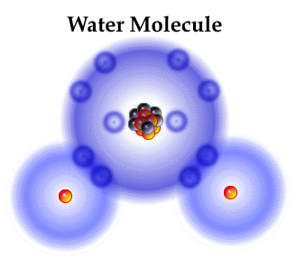
Water Chemistry

Slide 2
Contents
Types of water
Impurities
Hardness
Alkalinity
Softening of water

Slide 3
Sources of water
Surface water:
Rain water: Purest form of water.
River water: Contains dissolved chlorides, sulfates & bicarbonates of Na, Mg, Ca & Fe.
Lake water: Less minerals, high organic matter.
Sea water: Most impure form, containing dissolved salts.
Underground water
Spring water
Well water

Slide 4
Impurities
Physical
Chemical
Biological

Slide 5
1. Physical Impurities
S.No. | Type | Example | Effect
1. | Metallic substances | Salts of Fe, Mn, etc. | Color
2. | Colloidal impurities | Clay, slit, finely divided matter | Turbidity
 |  | Unusual amounts of salts | Brackish taste
 |  | Fe, Mn, Al, SO₄⁻², excess of lime | Bitter taste
 |  | Large amount of Na₂CO₃ | Soapy taste
 |  | Dissolved CO₂ & nitrates | Palatable taste
3. | Organic & Inorganic substances | Sulfides, alcohols, aldehydes, phenols, etc. | Odour

Slide 6
2. Chemical Impurities
S.No. | Type | Example | Effect
1. | Inorganic & organic chemicals | Toxic substances released from dyeing, paints, insectides, pesticides industry, etc. | On human health
2. | Dissolved oxygen |  | Corrosion

Slide 7
3. Biological Impurities
Microorganisms
Bacteria
Algae
Fungi

Slide 8
Hardness
Prevention of lathering of soap.
2C₁₇H₃₅COONa + Ca⁺²/Mg⁺² → (Mg⁺²/Ca⁺²)(C₁₇H₃₅COO)₂ + 2Na⁺
sod stearate Insoluble scum
(soap)

Slide 9
Types of Hardness
Temporary:
Dissolved bicarbonates of Ca, Mg & other heavy metals.
Carbonates of iron.
Removed by boiling water.
Ca(HCO₃)₂ CaCO₃ ↓ + H₂O + CO₂ ↑
Mg(HCO₃)₂ Mg(OH)₂↓ + 2CO₂↑
Permanent:
Due to dissolved chlorides & sulfates of Ca, Mg, Fe & other heavy metals.
Cannot be removed by boiling.

Slide 10
Advantages of Hardness
Better taste
Strength to teeth due to dissolved Ca⁺² ions
Prevention of poisonous lead in drinking water

Slide 11
Disadvantages of Hardness
Production of scum with soap
Washing and bathing
Cooking and drinking
Textile industry
Sugar industry
Dyeing industry
Paper industry
Laundry
Concrete
Pharmaceutical
Steam generation

Slide 12
Hardness-scale
ppm: Parts of CaCO₃ per 10⁶ parts of water.
mg/lt: mg of CaCO₃ in 1 lt of water.
Clarke’s degree (˚Cl): Parts of CaCO₃ per 70,000 parts of water.
Degree French (˚Fr): Parts of CaCO₃ equivalent hardness per 10⁵ parts of water.
Relation between different units:
1ppm = 1mg/lt = 0.1˚Fr = 0.07˚Cl

Slide 13
Degree of hardness/degree of hardness:
It is always expressed in terms of CaCO₃ :
Molecular weight is 100
Most insoluble salt
Equivalent of Ca CO₃

Slide 14
Determination of Hardness
EDTA Method
Soap Titration Method

Slide 15
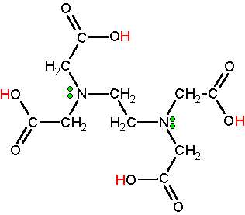
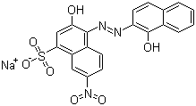
1. EDTA Method
Ethylene diamine tertraacetic acid
3-Hydroxy-4-(1-hydroxy-2-naphthylazo)-7-nitro-1-naphthalene sulfonic acid sodium salt
(Mordant Black 11)

Slide 16
Contd……….
Na₂H₂Y → 2Na⁺ + H₂Y⁻²
Disodium EDTA
Ca⁺²/Mg⁺² + HIn⁻² → Ca/Mg-In⁻ + H⁺
Blue Wine red
(Mg/Ca)In⁻ + H₂Y⁻² → CaY⁻ + HIn⁻ + H⁺
Colorless Blue

Slide 17
Advantages of EDTA Method
Greater accuracy
Easy to run
Rapid

Slide 18
2. Soap Titration Method
No indicator.
Indicated by the formation of lather, persisting for at least 2 minutes.

Slide 19
Problems…….
A water sample contains 204mg of CaSO₄ per litre. Calculate the hardness in terms of CaCO₃.
How many grams of FeSO₄ dissolved per litre gives 210.5ppm of hardness?
Calculate the temporary and permanent hardness of a water sample containing: Mg(HCO₃)₂ = 7.3mg/lt; Ca(HCO₃)₂ = 16.2mg/lt; MgCl₂ = 9.5mg/lt; CaSO₄ = 13.6mg/lt.

Slide 20
Alkalinity
Responsible ions: CO₃⁻², HCO₃⁻, OH⁻
Coexisting ions: CO₃⁻²-HCO₃⁻ & CO₃⁻²-OH⁻
HCO₃⁻—OH⁻:
HCO₃⁻ + OH⁻ → CO₃⁻² + H₂O
Indicators: Phenolphthalein
Methyl orange

Slide 21
Calculation of Alkalinity of water
OH⁻ + H⁺ → H₂O [P]
CO₃⁻² + H⁺ → HCO₃⁻ [M]
HCO₃⁻ + H⁺ → H₂O + CO₂
Relation between P & M | OH⁻ | CO₃⁻² | HCO₃⁻
P = 0 | 0 | 0 | M
P = 1/2M | 0 | 2P | 0
P < 1/2M | 0 | 2P | (M – 2P)
P > 1/2M | (2P - M) | 2(M - P) | 0
P = M | M | 0 | 0

Slide 22
SOFTENING OF HARD WATER
Lime-soda process
Zeolite or permutit process
Calgon process
Ion exchange or deionization or de-mineralization process

Slide 23
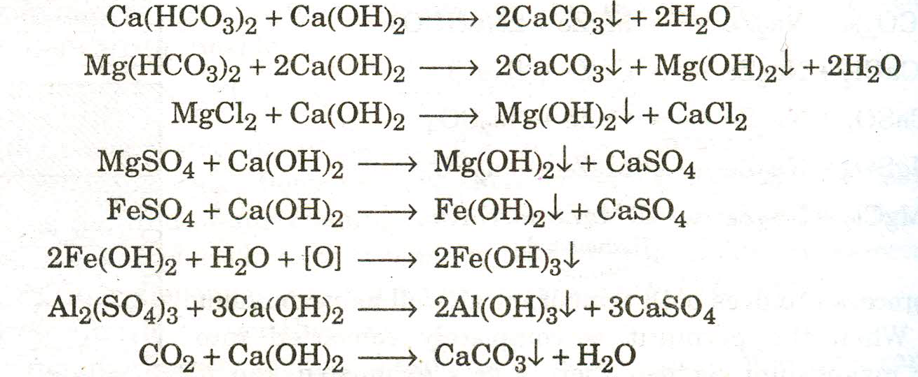
1. Lime-soda process
Lime removes temporary & permanent hardness (mainly due to Mg; not useful for Ca).

Slide 24
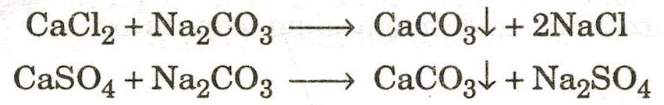
Contd…..
Soda removes permanent hardness due to Ca.

Slide 25
Types of Lime soda process
Two types:
Cold lime-soda process
Hot lime-soda process

Slide 26
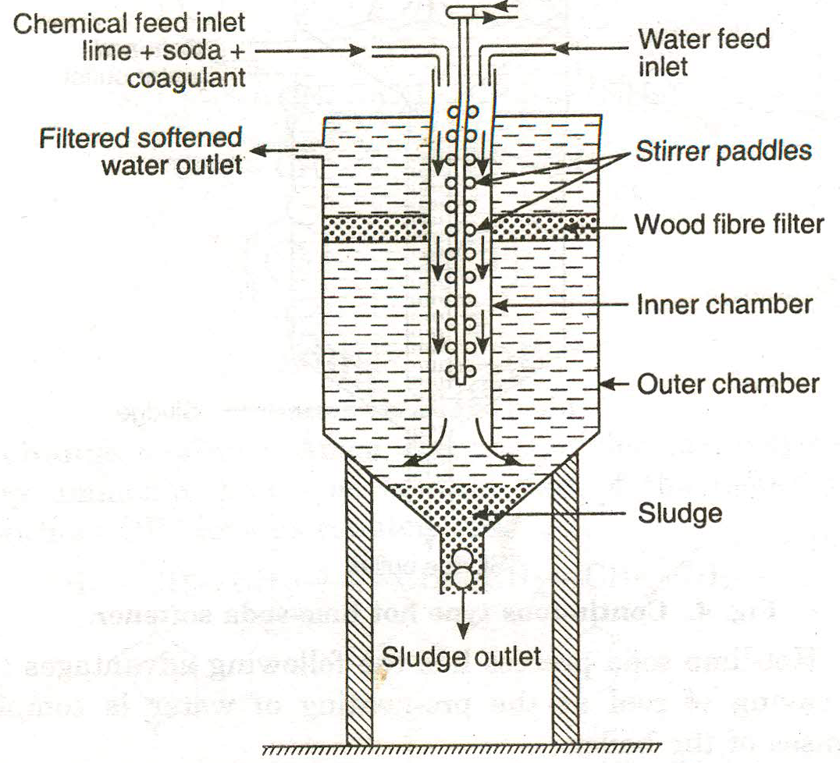
Cold Lime-soda process
Calculated amount of lime/soda mixed with water at RT.
Addition of coagulants to increase the size of precipitate.

Slide 27
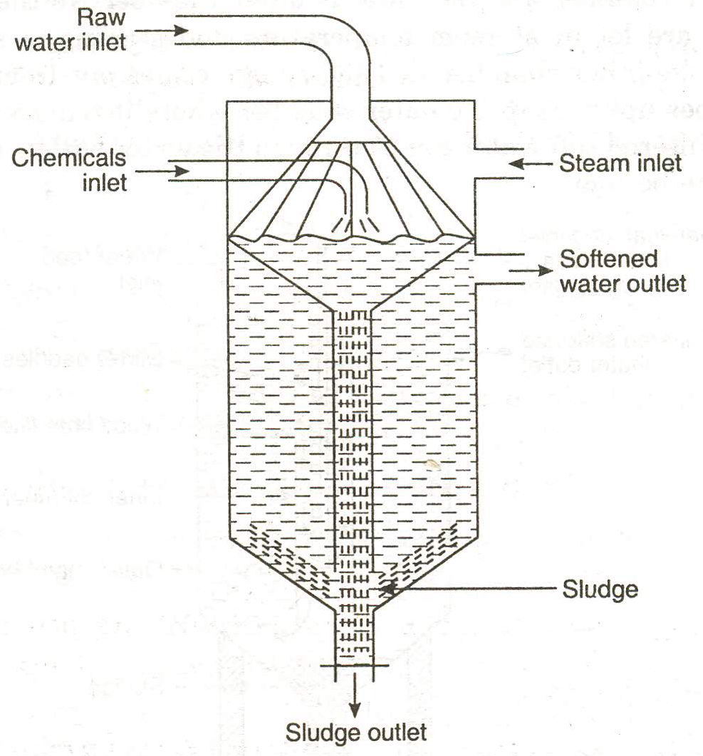
Hot L-S Process
Reaction at 80-150˚C.
Saving of coal.
Required time is reduced.
Requirement of chemicals is reduced.
No coagulant is required.

Slide 28
Impt……
Lime requirement for temporary Mg hardness is double w.r.t. that for Ca hardness.
Lime removes permanent Mg hardness, but introduces an equivalent amount of permanent Ca hardness.
Soda is required for permanent Ca hardness. Generated Ca hardness also requires soda to be removed.

Slide 29
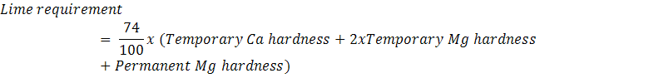
Calculations

Slide 30
Problem……
Calculate the amount of lime-soda needed for softening of water containing following per litre:
Ca(HCO₃)₂ = 162mg; Mg(HCO₃)₂ = 73mg; MgCl₂ = 95mg; CaSO₄ = 136mg; NaCl = 585mg.
What is the temporary and permanent hardness of the sample?

Slide 31
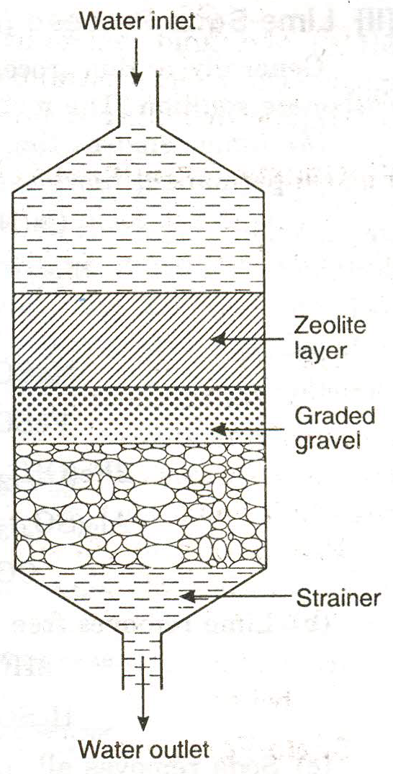
2. Zeolite Process
Zeolite: Sodium aluminium orthosilicate (Na₂O.Al₂O₃.xSiO₂.yH₂O)
where, x = 2-10; y = 2-6.
Natural or synthetic.
Exchange their Na⁺ ions by Ca⁺² or Mg⁺² ions in hard water.

Slide 32
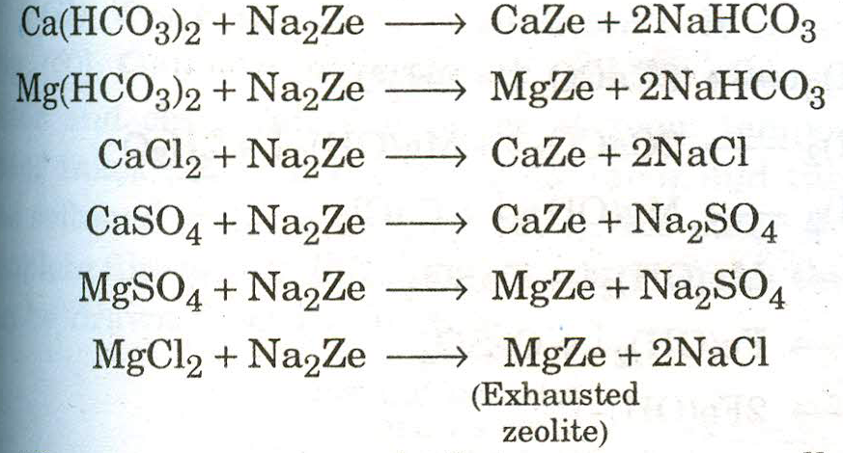
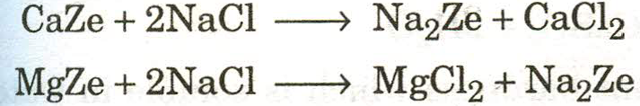
Chemistry involved
Reusage of exhausted zeolite:

Slide 33
Limitations:
Water must be free from suspended matter & acids.
Colored impurities should not be there.
Lead can’t be removed.
Advantages:
Zero hardness.
Small equipment, easy to operate.
No sludge formation.
Economic.
Disadvantages:
More sodium.
HCO₃⁻ & CO₃⁻² is not removed.
No treatment to high turbidity.
Liberation of free CO₂.

Slide 34
Problem…..
Hardness of 10,000lt of a water sample was completely removed by passing it through a zeolite softener. Zeolite softener required 200lt of NaCl solution containing 20,000mg/lt of NaCl for regeneration. Calculate the hardness of water sample.

Slide 35
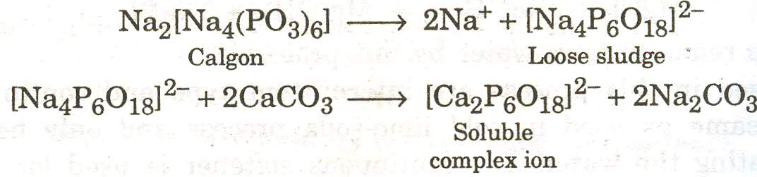
3. Calgon Process
Calgon: Sodium hexametaphosfate [Na₂P₆O₁₈]

Slide 36
4. Ion Exchange Process
Reversible process of ion exchange between stationary ion exchange phase & external liquid mobile phase.
Types of Ion Exchange Resins:
Cation exchange resin
Anion exchange resin

Slide 37
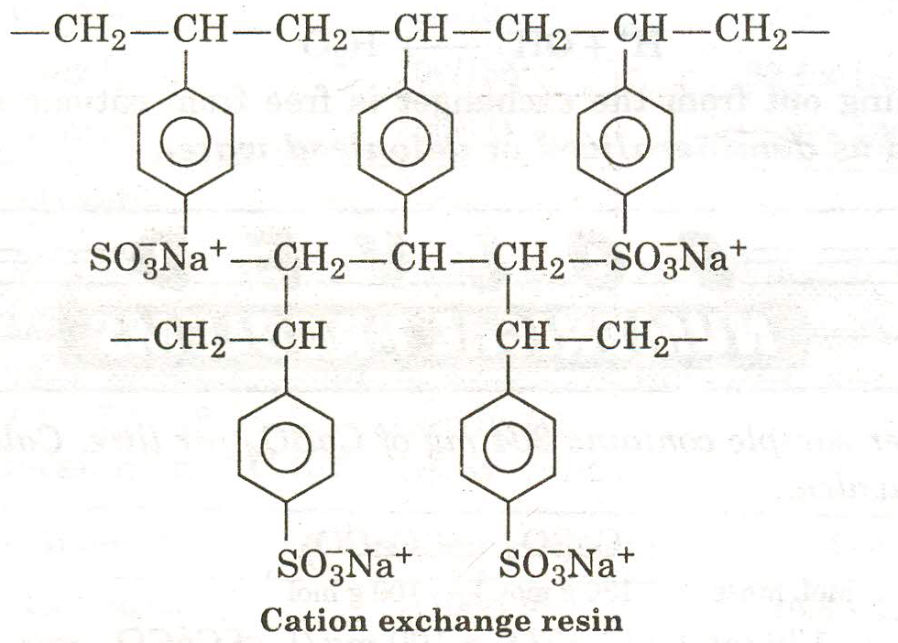
Cation Exchange Resin
Containing immovable sulfate ions & equal numbers of replaceable Na⁺ ions.

Slide 38
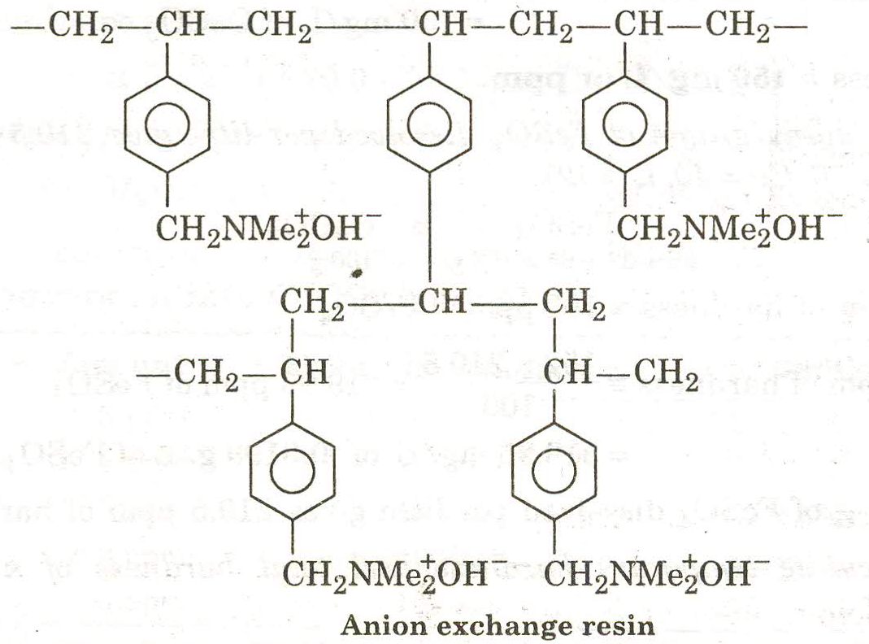
Anion Exchange Resin
Containing amine or quaternary ammonia groups & equivalent amount of replaceable anions, e.g. OH⁻.

Slide 39
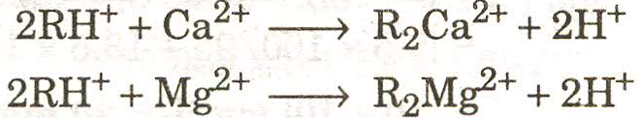
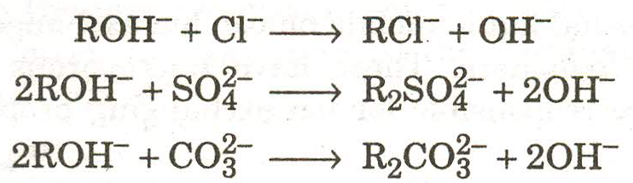
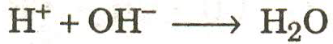
Reactions
Regeneration of exchange resins:
R₂Ca⁺² + 2H⁺ → 2RH⁺ + Ca⁺² (washings)
R’₂SO₄⁻² + 2OH⁻ → 2R’OH⁻ + SO₄⁻² (washings)

Slide 40
Advantages:
For the softening of acidic as well as alkaline water.
Produces water of very low hardness.
Disadvantages:
Costly.
Expensive chemicals.

